Slide 1
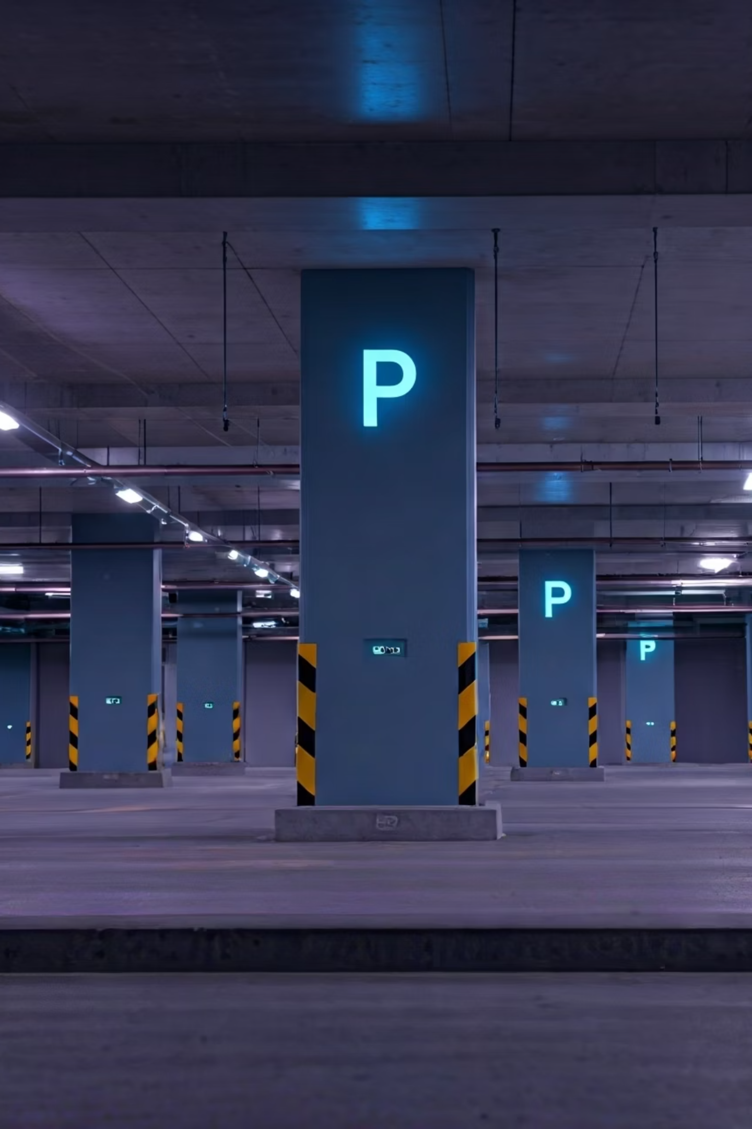
The Smart Parking System: Real-time Efficiency
This presentation introduces an innovative, automated solution for parking management, designed to tackle the common challenges of urban parking. By leveraging the power of dual microcontrollers—the ESP32 and Arduino UNO—our system provides real-time parking slot monitoring and seamless vehicle exit control. The result is a low-cost, modular, and scalable design that not only enhances the user experience but also paves the way for smarter, more efficient urban environments.
Lk
by Lavith kumar

Slide 2
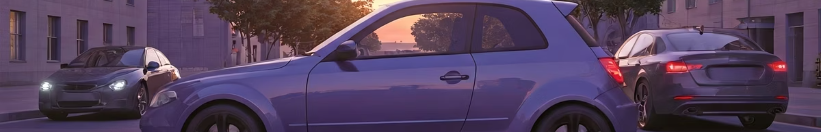
The Parking Problem: Urban Congestion & Frustration
Wasted Time
Economic Burden
Drivers spend an average of 17 hours annually searching for parking, leading to significant personal frustration and lost productivity.
This inefficiency translates to an average annual cost of $345 per driver in wasted time and fuel, impacting household budgets.
Traffic Congestion
Lack of Information
Up to 30% of urban traffic is attributed to vehicles circling in search of parking, exacerbating congestion and increasing emissions.
The absence of real-time parking availability data is a primary driver of this inefficiency, creating unnecessary delays and stress.

Slide 3
Our Solution: Dual-Controller Smart Parking
Our innovative smart parking system utilizes a dual-controller architecture to optimize efficiency and reliability. The ESP32 module is dedicated to real-time parking slot monitoring, providing accurate occupancy data.
By segmenting these critical tasks, our solution aims to reduce parking search time by 60% and significantly improve overall traffic flow within parking facilities. This integrated yet independent approach enhances system reliability and simplifies troubleshooting.
Concurrently, the Arduino UNO module manages the automated vehicle exit process, including the barrier control. This distributed system ensures robust performance and modularity, allowing each controller to specialize in its core function.
ESP32: Real-time slot monitoring
Arduino UNO: Automated vehicle exit and barrier
Distributed system for robustness
60% reduction in search time target

Slide 4
ESP32 Module: Real-time Slot Monitoring
1
Sensor Network
The ESP32 monitors six individual parking slots, each equipped with its own TCRT5000 IR sensor for precise occupancy detection.
2
Data Processing
Sensor data is processed by the ESP32 every 500ms, ensuring near real-time updates on slot availability.
3
LCD Display
The current status of "Slot X: Full/Empty" is clearly displayed on a 16x2 LCD, utilizing an I2C interface for efficient communication.
4
Dynamic View
The display rotates every 3 seconds, showing two parking slots at a time to provide a comprehensive overview without overwhelming the user.
5
Power Efficiency
The ESP32 module maintains an average power consumption of approximately 80mA, making it suitable for continuous operation.

Slide 5
Arduino UNO Module: Automated Exit Control
The Arduino UNO module is dedicated to ensuring a smooth and automated vehicle exit. It employs a separate TCRT5000 IR sensor strategically placed at the exit point to detect departing vehicles.
100ms
Upon detection, the Arduino UNO swiftly triggers a servo-powered lid. The SG90 micro servo is activated within 100ms of detection, providing a rapid and hands-free exit mechanism for vehicles.
Activation Speed
Servo activated within 100 milliseconds of vehicle detection at exit.
50mA
Power Usage
Arduino UNO's average power consumption, ensuring energy efficiency.
This dedicated exit control minimizes bottlenecks and improves overall traffic flow within the parking facility.

Slide 6
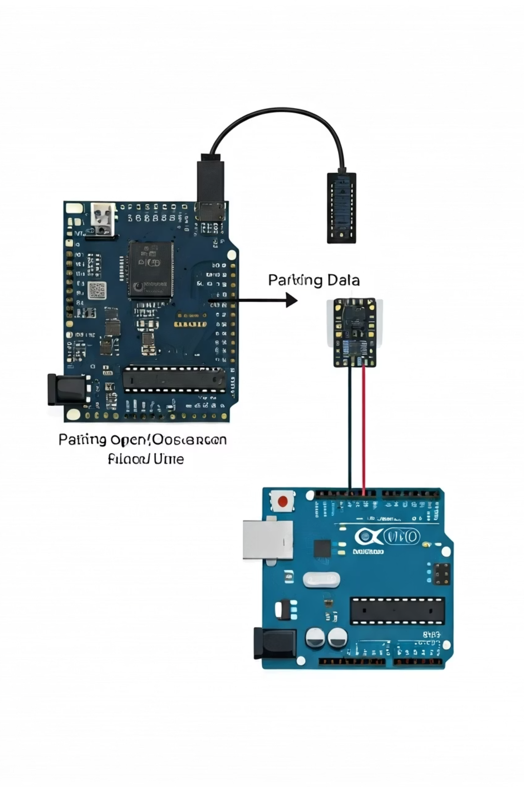




System Interoperability & Workflow
ESP32: Status Updates
Independently monitors and updates parking slot statuses based on real-time occupancy data from IR sensors. This process runs continuously.
Arduino UNO: Exit Control
Independently manages the exit barrier, activating the servo mechanism only when a vehicle is detected at the exit sensor.
Streamlined Flow
The overall workflow is intuitive: drivers park, ESP32 updates availability; drivers exit, UNO automates the barrier.
Minimal Communication
Cross-controller communication is kept minimal, enhancing system simplicity, reliability, and reducing potential points of failure.
This segmented task management significantly enhances overall parking efficiency, ensuring specialized and reliable operation for both entry and exit processes.

Slide 7





Key Features & Advantages
Low-Cost
Utilizes readily available and affordable components, reducing deployment costs by an estimated 70% compared to conventional systems.
Modularity
Designed as self-contained 6-slot units, allowing for easy assembly, maintenance, and expansion as needed.
Scalability
The system can be expanded to manage hundreds of slots by simply integrating multiple modules, suitable for any parking facility size.
Real-time Visibility
Provides instant and accurate status updates on the LCD, guiding drivers directly to available slots and minimizing search time.
Automation
The automated exit barrier significantly reduces the need for human intervention, streamlining traffic flow and improving user convenience.

Slide 8
Technical Specifications
Microcontrollers
Espressif ESP32-WROOM-32D, Arduino UNO R3
Sensors
TCRT5000 IR Obstacle Avoidance Sensors (7 total: 6 for slots, 1 for exit)
Display
16x2 I2C LCD Module for clear, real-time slot status
Actuator
SG90 9G Micro Servo Motor, controlling the automated exit lid
Power Supply
Standard 5V DC (e.g., 2A adapter) to power both modules and peripherals
Software
Programmed using Arduino IDE with C/C++ language for efficient code execution
These robust components ensure the system's reliability and performance in a variety of parking environments.

Slide 9
Scalability & Future Enhancements
Larger Deployments
Easily integrate multiple 6-slot modules to scale up for multi-level parking garages and large commercial lots, creating a comprehensive network.
Mobile Integration
Leverage the ESP32's built-in Wi-Fi capabilities to enable real-time mobile application connectivity, offering live parking maps and navigation to users.
Data Analytics
Collect valuable occupancy data to implement predictive analytics, optimizing parking space utilization and enabling dynamic pricing strategies for peak demand.
Navigation Aids
Integrate smart LEDs or directional signs within the facility to guide drivers directly to the nearest empty parking slots, further reducing search time.
Payment Gateway
Incorporate automated payment processing upon vehicle exit, offering a seamless and convenient experience for users and streamlining revenue collection.

Slide 10

Conclusion: Smart Parking for Smarter Cities
The Smart Parking System offers an efficient, low-cost, and robust solution for modern parking management. Its dual-controller design, leveraging the ESP32 and Arduino UNO, ensures specialized and reliable operation, providing real-time information and automation for users.
This system is not just a standalone product; it forms the foundation for highly scalable and integrated urban parking networks, ready for future enhancements like mobile integration and data analytics. By adopting this technology, cities can significantly enhance urban mobility, reduce traffic congestion, and minimize environmental impact, paving the way for smarter, more sustainable urban living.
Presented By

